Slide 1

Wall-to-Wall (W2W) Process
Presented to:
CAV RP Symposium
Presented by:
Benjamin Beddis
N85B2
2 September 2026

Slide 2
Objectives
  What is the Wall-to-Wall (W2W) process?
  Submission Information
  “Cycle” Counts
  Stock Reconciliation Report
  W2W Example
  Questions

Slide 3
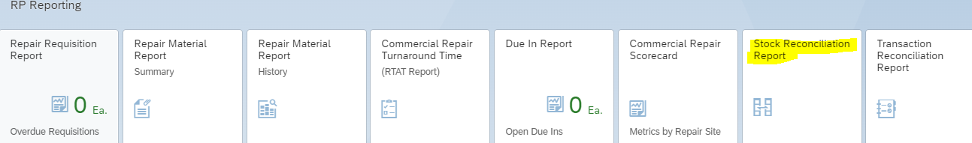
Statement of Work – NWCF Annual Inventory Accountability Responsibilities
  The contractor must maintain 100% inventory validity of physical material compared to CAV RP balances at the NIIN and condition code level for CAV-RP reportable material (Paragraph D.1).
  An end-to-end 100% inventory or a cycle count that results in 100% of inventory being touched will be completed by 31 July of each reporting period (1 October – 31 July) (Paragraph D.2).
  In addition to 100% completion, all open discrepancies must be resolved by 31 of August (Paragraph D.2).
  The contractor will complete a physical count by printing two Stock Reconciliation Reports, one with quantities and one without (Paragraph D.2.a).

Slide 4
Wall-to-Wall (W2W) Process
The W2W requirement is a physical inventory count of all Navy Working Capital Fund (NWCF) assets.
Count everything under the assigned RIC!
  If NWCF are located at multiple locations, they MUST be counted.
  Coordination between locations and programs is vital for the most accurate W2W submission.
Contractors are required to complete a NIIN and condition code in one day (Paragraph D.2.a.).
The process is vital for NAVSUP’s inventory management and accountability of all NWCF among the commercial vendors.

Slide 5
Wall-to-Wall (W2W) Process
When can commercial vendors begin submitting for FY27?
  Physical count and submissions can begin the start of the Fiscal Year (October 1st)
Complete the count ASAP!
  DO NOT DELAY conducting and submitting the physical count.
How many submissions are needed for my RIC?
One Submission per RIC
each Fiscal Year!

Slide 6
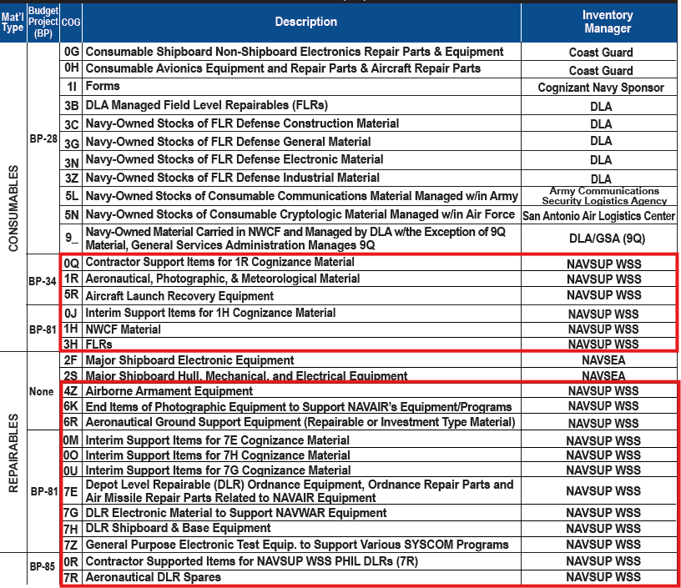
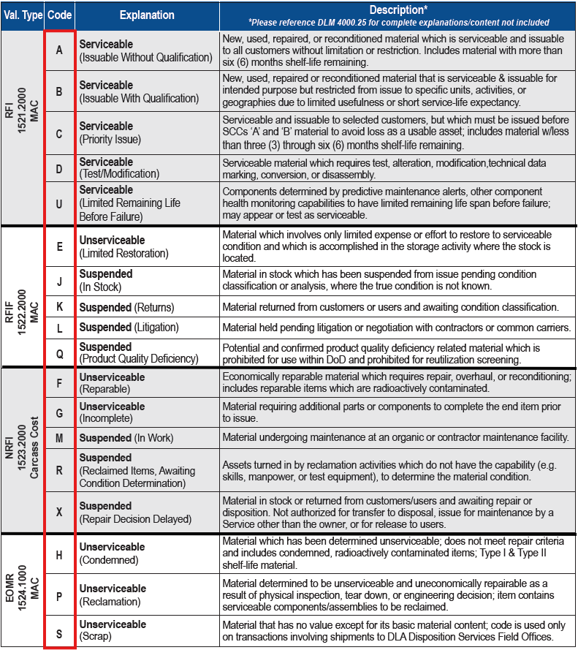
COGs and Condition Codes

Slide 7
Appendix A Information
The template (Appendix A) can be found in the CAV SOW at Paragraph D.2.c: https://www.navsup.navy.mil/NAVSUP-Enterprise/NAVSUP-Weapon-Systems-Support/Provisions-Instructions-and-Contract/
  This is the only template accepted for W2W submissions.
Please e-mail to usn.mechanicsburg.navsupwssmech.mbx.cav-w2w-inventory@us.navy.mil (Paragraph D.2.d).
  Please include your CAV analyst on the submission.
The quarterly confirmation template is not the accepted template for the W2W submission.

Slide 8
Physical W2W Cycle Count
New to the CAV SOW (Paragraph D.2.b)
Performance-Based Logistic contractors (PBLs) are allowed to count by serial number due to the large volume of NWCF assets and sub-vendor locations holding those assets. These cycle counts allow the contractors to sporadically count throughout the fiscal year.
Requests for approval to conduct the inventory count by serial number must be submitted to the CAV W2W inbox for approval.
  If approved, the submissions must have all physically counted serial numbers and the associated NIIN and condition codes as well as the exact date.
For tracking and visibility, the commercial vendor will indicate on the report submitted when a specific NIIN and condition code is fully inventoried and complete.
Notes:
Cycle counts still require the start and completion of a NIIN and condition code within one day. This prevents re-counting the same NIIN and condition code throughout the year.
A NIIN does not need to be completed at once.

Slide 9
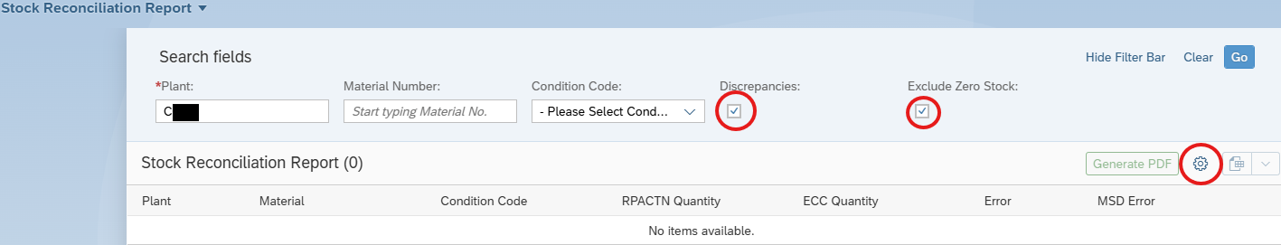
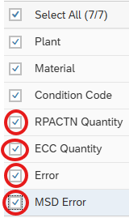
Stock Reconciliation Report – Counter Responsibility
There must be a counter and validator and may be a second counter if a discrepancy is noted (Paragraph D.2.a).
Use material summary report (not shipped) to identify any discrepancies.

Slide 10
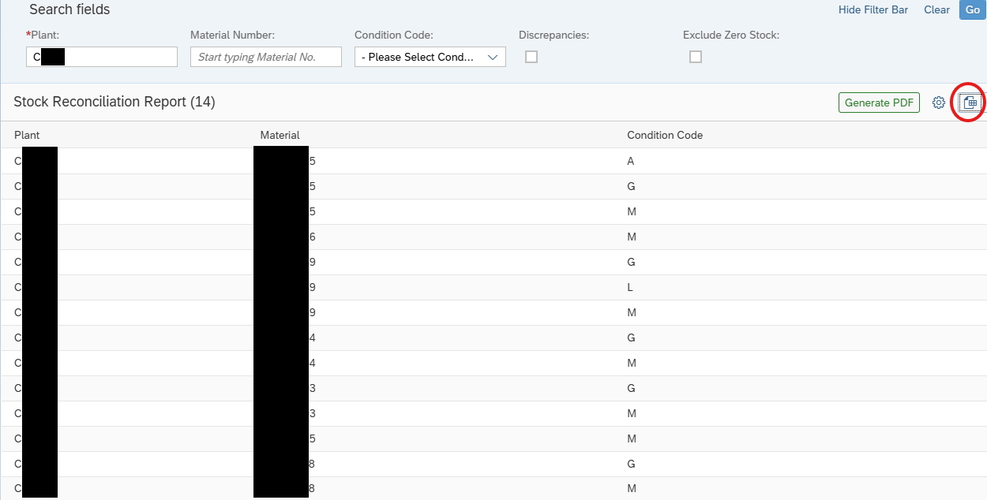
Stock Reconciliation Report – Counter Responsibility

Slide 11
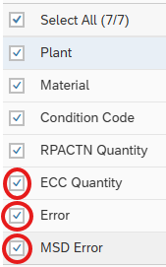
Stock Reconciliation Report – Validator Responsibility
The validator will compare the filled-out count sheet to the report with quantities. The validator will annotate any discrepancies on the count sheet (Paragraph D.2.a).
The validator will annotate any discrepancies on the count sheet. If there are discrepancies, a second counter will print a new count sheet and recount the discrepant NIIN(s). If resolved, this will be annotated on the blank sheet (Paragraph D.2.a).

Slide 12
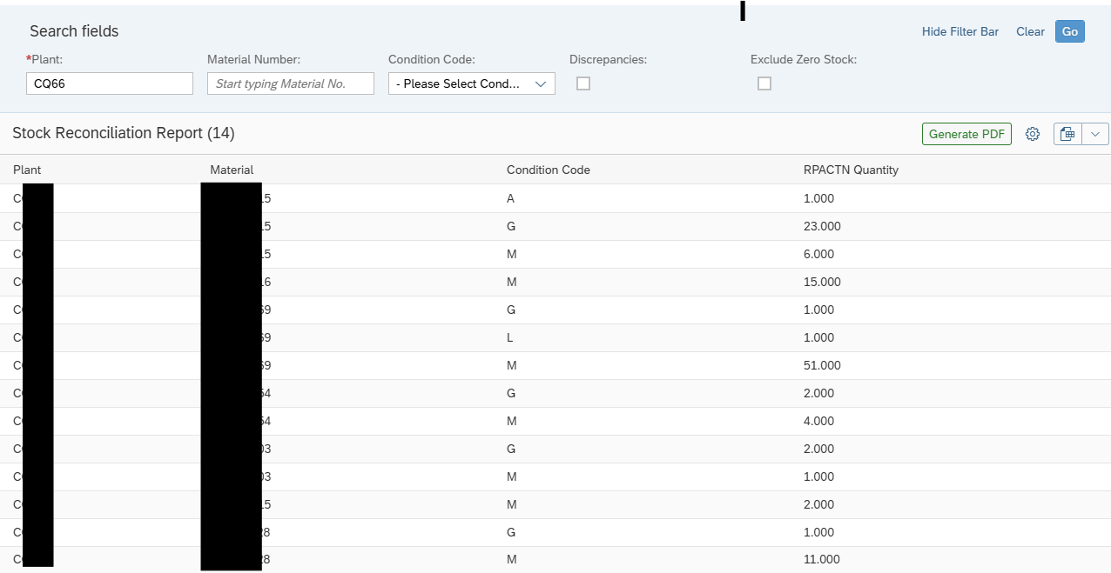
Stock Reconciliation Report – Validator Responsibility

Slide 13
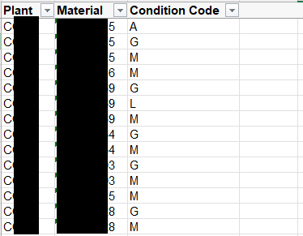
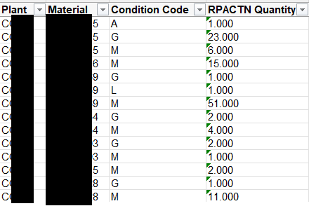
Stock Reconciliation Reports
Counter Stock Reconciliation Pull
Validator Stock Reconciliation Pull
The first counter will legibly print their names, sign, and date the count sheets. The validator will legibly print their name, sign, and date all reports. The Contractor must retain all reports for ten (10) years.

Slide 14
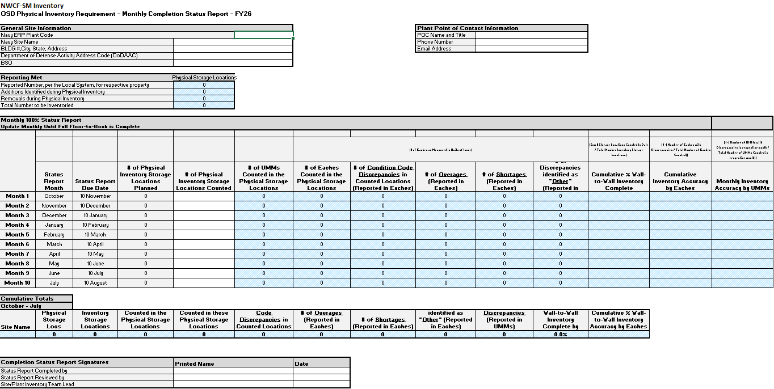
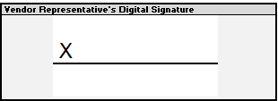
Monthly Report Tab

Slide 15
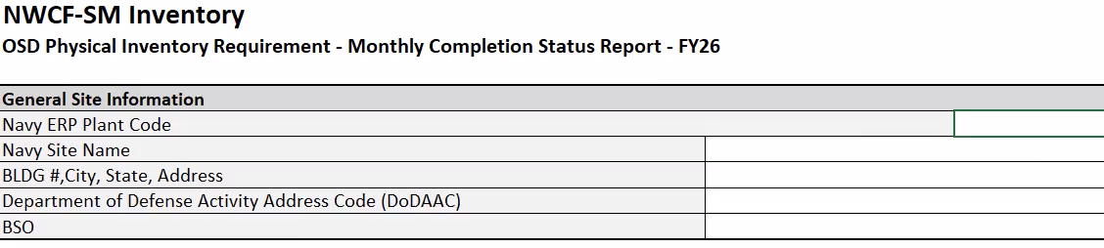
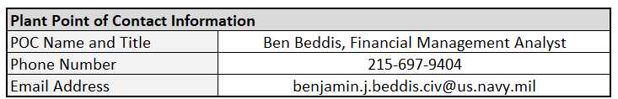
Monthly Report Tab Example
Notes:
NAVY ERP Plant Code: contractor RIC (C + RIC)
Navy Site Name: contractor Name
BLDG #, City, State Address: contractor Address
Department of Defense Activity Address Code (DoDAAC): DoDAAC
Budget Submitting Office (BSO): NAVSUP WSS

Slide 16
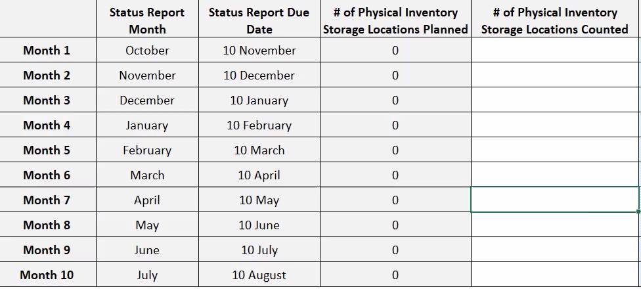
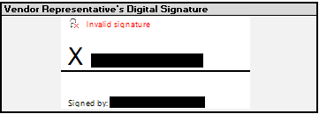
Monthly Report Tab Example Continued
Digital Signature required. If you cannot digitally sign, please print the sheet, physically sign, scan and submit as a pdf.

Slide 17
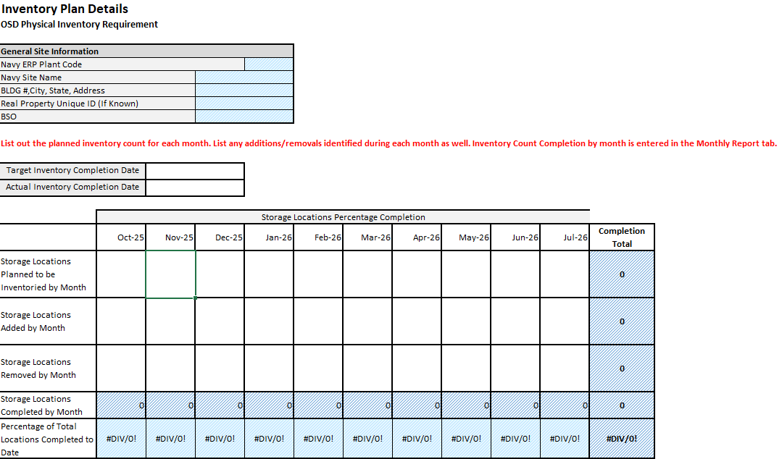
Inventory Plan Tab

Slide 18
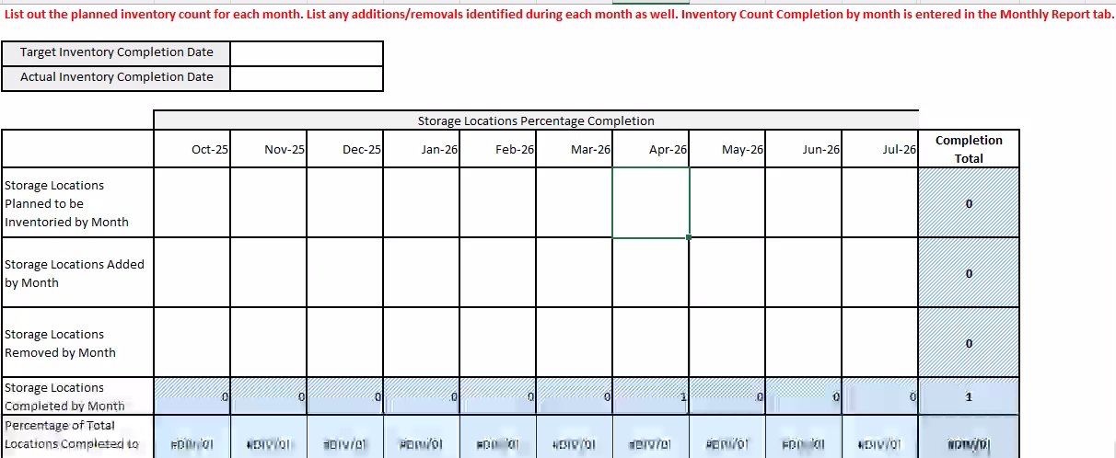

Inventory Plan Example Tab
The Storage Locations Planned to be Inventoried by Month should match the # of Physical Locations on the Monthly Report tab.
  The tab must show 100% if physical count is completed.

Slide 19
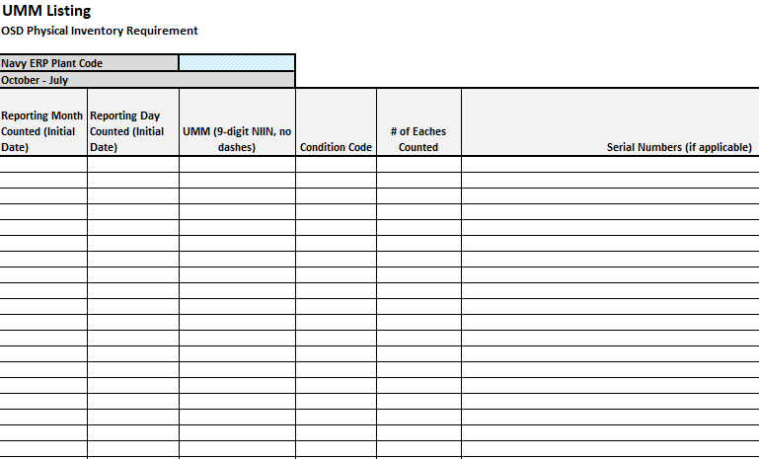
UMM (NIINs) Listing Tab
(Paragraph D.2.d)

Slide 20
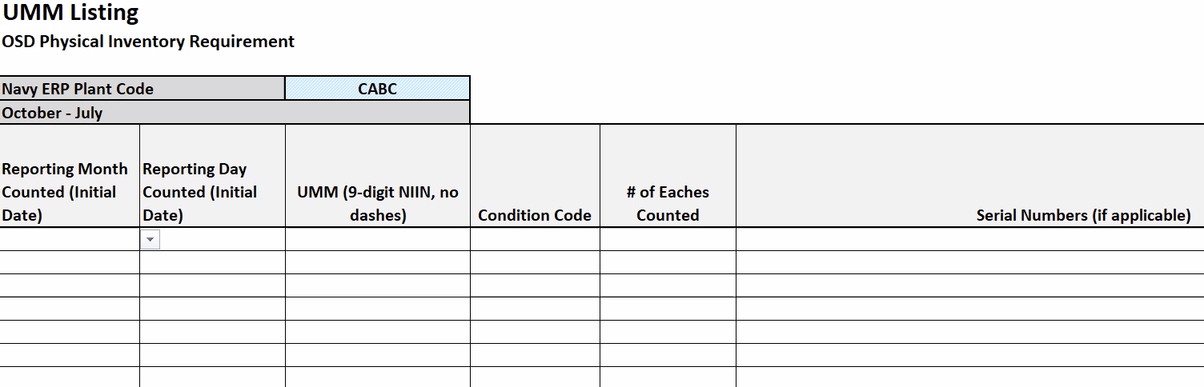
UMM (NIINs) Listing Tab Example
The list consists of the day and month of the count, the NIIN (not part number, no dashes), the condition code, and the number of assets physically counted by the contractor.
Every NIIN and condition code must be added.
If a NIIN has more than one condition code, each must be listed out for each quantity.

Slide 21
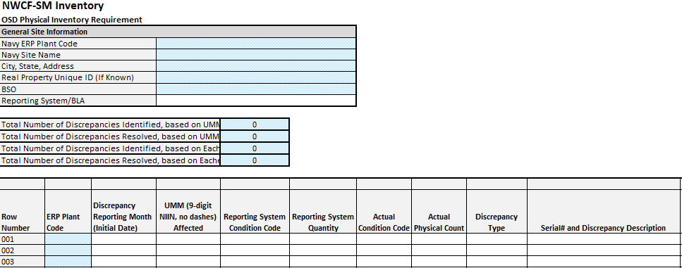
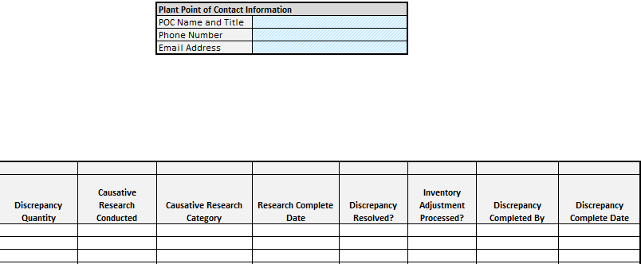
Discrepancy Tracker Tab
(Paragraph D.2.e)
**Columns A to K**
**Columns L to S**

Slide 22
Discrepancy Tracker Tab
(Paragraph D.2.e)
A discrepancy is an identified variance of a NIIN and condition code between the contractor's completed physical count with CAV RP.
Discrepancies must be noted in detail (specifically a serial number).
Work with your CAV RP analyst to resolve all discrepancies within 30 days of the template being approved by the W2W team.
If discrepancies are resolved and processed in CAV RP after the original submission, a new submission will need to be re-signed and re-submitted.

Slide 23
Types of Discrepancies
  Condition Code – The asset is physically counted in a different condition code compared to CAV RP.
  Overage – More assets are physically counted than what is reported in CAV RP. Contractor is reporting additional assets.
  Shortage – Less assets are physically counted than what is reported in CAV RP.
    NOTE – If a shortage cannot be resolved, an LDD is needed.
  Other - Processing error resulting in the transaction not reflecting correctly

Slide 24
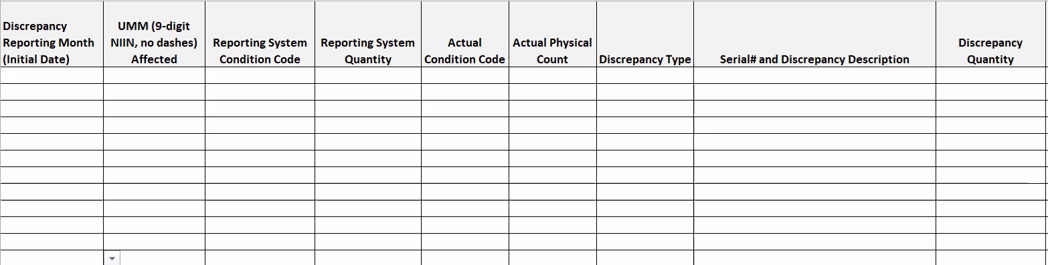
Discrepancy Tracker Example Tab
For the condition code discrepancy quantity, you must enter the quantity between CAV-RP and what was physically counted.

Slide 25
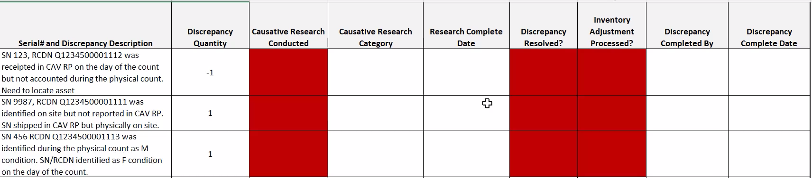

Discrepancy Tracker Tab (Continued)
  Discrepancy Resolved and Inventory Adjustment Processed can be answered YES if the contractor is able to correct the discrepancy and make any necessary adjustments to align the physical count.
  If answered NO, a new template will need to be submitted once all discrepancy are resolved.

Slide 26
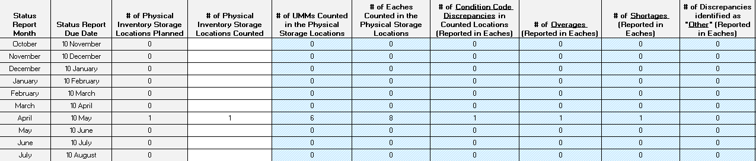
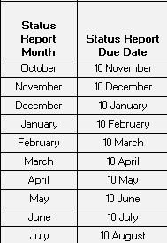
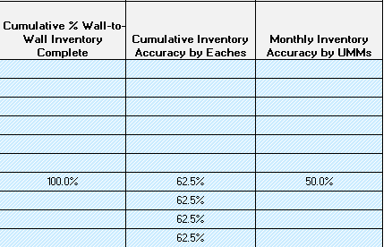
W2W Results (Monthly Report Tab)

Slide 27
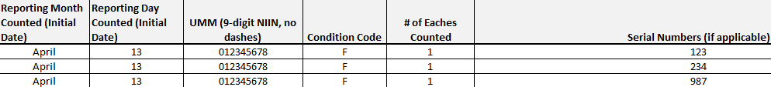
POP QUIZ
    Which formatting is correct on the UMM (NIINs) Listing tab?
a.
b.
NIIN/CC reports on one row

Slide 28



POP QUIZ
    Which formatting is correct on the UMM (NIINs) Listing tab?
a.
b.
9 DIGIT NIIN, NO DASHES
c.

Slide 29
POP QUIZ
    Which locations need to be included for the RIC?
ALL LOCATIONS HOLDING NWCF
.

Slide 30
POP QUIZ
    Which Condition Codes need to be submitted with your RIC?
ALL CONDITION CODES REPORTED UNDER THE RIC!
.

Slide 31
POP QUIZ
    How many W2W submissions are required for a RIC each FY?
ONE
.

Slide 32
POP QUIZ
    When should you start the physical count and submit for FY27?
AS SOON AS POSSIBLE STARTING OCTOBER 1ST!!
.

Slide 33
Questions?
W2W POCs:
usn.mechanicsburg.navsupwssmech.mbx.cav-w2w-inventory@us.navy.mil
benjamin.j.beddis.civ@us.navy.mil (PHIL)
james.p.bradley48.civ@us.navy.mil (PHIL)
amy.s.rivera.civ@us.navy.mil (MECH)
lauren.r.evans10.civ@us.navy.mil (MECH)

